Slide 1

YSC2239 Lecture 8

Slide 2
Recap
Population, Sample, Parameter, Statistic
Probability Distribution, Empirical Distribution
Case study: jury selection (recommended)
sample_proportions(sample_size, probabilities)

Slide 3
Today’s class
Decisions and Uncertainty
p-values
A/B testing
Reading: Chapter 11, 12

Slide 4
Decisions and Uncertainty

Slide 5
Incomplete Information
We are trying to choose between two views of the world, based on data in a sample.
It is not always clear whether the data are consistent with one view or the other.
Random samples can turn out quite extreme. It is unlikely, but possible.

Slide 6
Terminology

Slide 7
Testing Hypotheses
A test chooses between two views of how data were generated
E.g. Alameda jury panel in the previous lecture: truly random panel or is it a biased panel?
The views are called hypotheses
The test picks the hypothesis that is better supported by the observed data

Slide 8
Null and Alternative
The method only works if we can simulate data under one of the hypotheses.
Null hypothesis
A well defined chance model about how the data were generated
We can simulate data under the assumptions of this model – “under the null hypothesis”
Alternative hypothesis
A different view about the origin of the data

Slide 9
Test Statistic
The statistic that we choose to simulate, to decide between the two hypotheses
E.g. total variation distance between the proportion of a randomly generated jury panel and the population proportion in Alameda
Questions before choosing the statistic:
What values of the statistic will make us lean towards the null hypothesis?
What values will make us lean towards the alternative?
Preferably, the answer should be just “high”. Try to avoid “both high and low”.

Slide 10
Prediction Under the Null Hypothesis
Simulate the test statistic under the null hypothesis; draw the histogram of the simulated values
This displays the empirical distribution of the statistic under the null hypothesis
It is a prediction about the statistic, made by the null hypothesis
It shows all the likely values of the statistic
Also how likely they are (if the null hypothesis is true)
The probabilities are approximate, because we can’t generate all the possible random samples

Slide 11
Conclusion of the Test
Resolve choice between null and alternative hypotheses
Compare the observed test statistic and its empirical distribution under the null hypothesis
If the observed value is not consistent with the distribution, then the test favors the alternative – “rejects the null hypothesis”
Whether a value is consistent with a distribution:
A visualization may be sufficient
If not, there are conventions about “consistency”

Slide 12
Statistical Significance

Slide 13
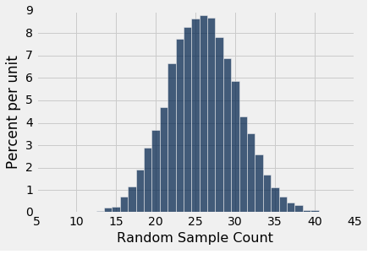
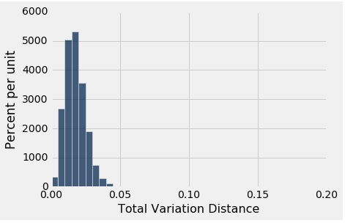
Tail Areas

Slide 14
Conventions About Inconsistency
“Inconsistent”: The test statistic is in the tail of the empirical distribution under the null hypothesis
“In the tail,” first convention:
The area in the tail is less than 5%
The result is “statistically significant”
“In the tail,” second convention:
The area in the tail is less than 1%
The result is “highly statistically significant”
(Demo)

Slide 15
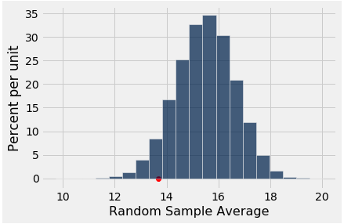
The p-Value as an Area
Empirical distribution of the test statistic under the null hypothesis.
Red dot denotes the observed statistic.
Yellow area denotes the tail probability (p-value).
Distribution under the
Null Hypothesis

Slide 16
Definition of the p-value
Formal name: observed significance level
The p-value is the chance (probability),
under the null hypothesis,
that the test statistic
is equal to the value that was observed in the data
or is even further in the direction of the alternative.
Last two bullets mean: “test statistic is at least as extreme as the observed value.”

Slide 17
Origin of the Conventions

Slide 18
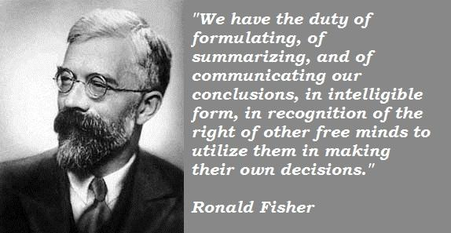
Sir Ronald Fisher, 1890-1962

Slide 19
Sir Ronald Fisher, 1925
“It is convenient to take this point [5%] as a limit in judging whether a deviation is to be considered significant or not.”
–– Statistical Methods for Research Workers

Slide 20
Sir Ronald Fisher, 1926
“If one in twenty does not seem high enough odds, we may, if we prefer it, draw the line at one in fifty (the 2 percent point), or one in a hundred (the 1 percent point). Personally, the author prefers to set a low standard of significance at the 5 percent point …”

Slide 21
To-do
Lab 4
Assignment 4

